Slide 1
Stress Orientation Rotation of the 2018 Mw 7.5 Palu Earthquake

Slide 2
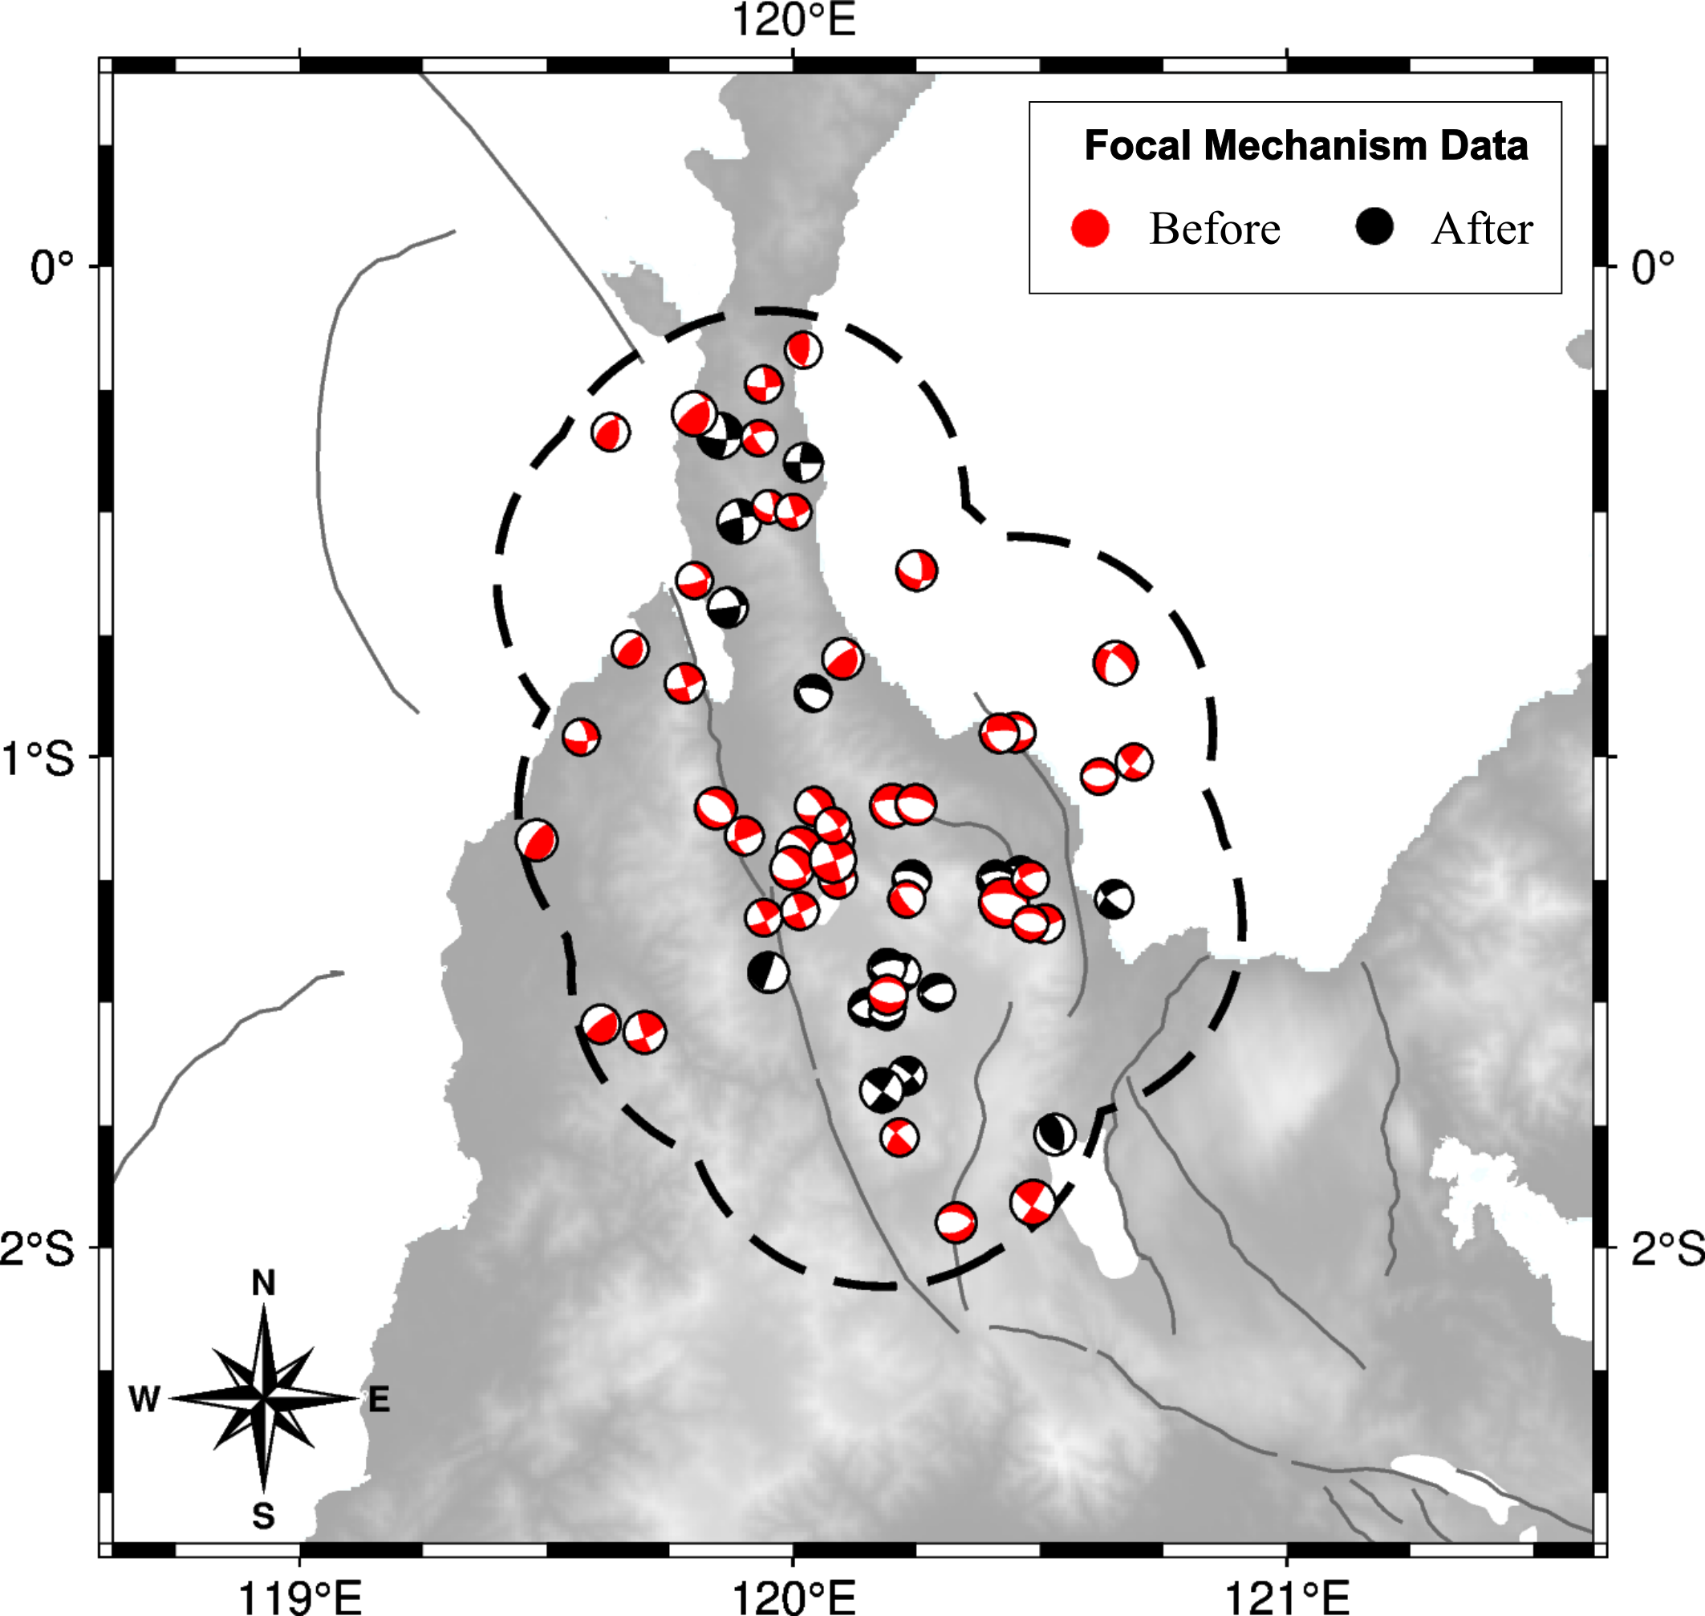
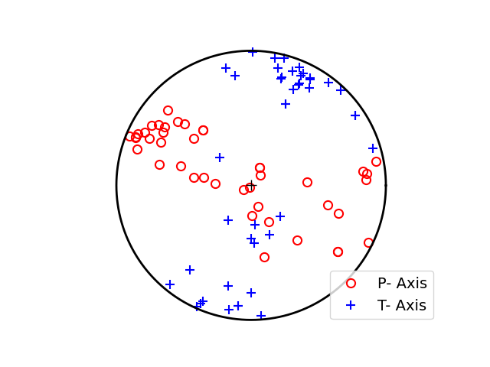
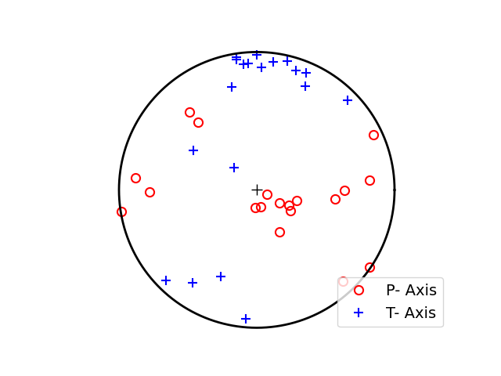
Focal Mechanisms Data
Before 2018 Mw7.5 Palu
43 events
May 1977 – Sep 2018
After 2018 Mw7.5 Palu
19 events
Sep 2018 – Nov 2021

Slide 3
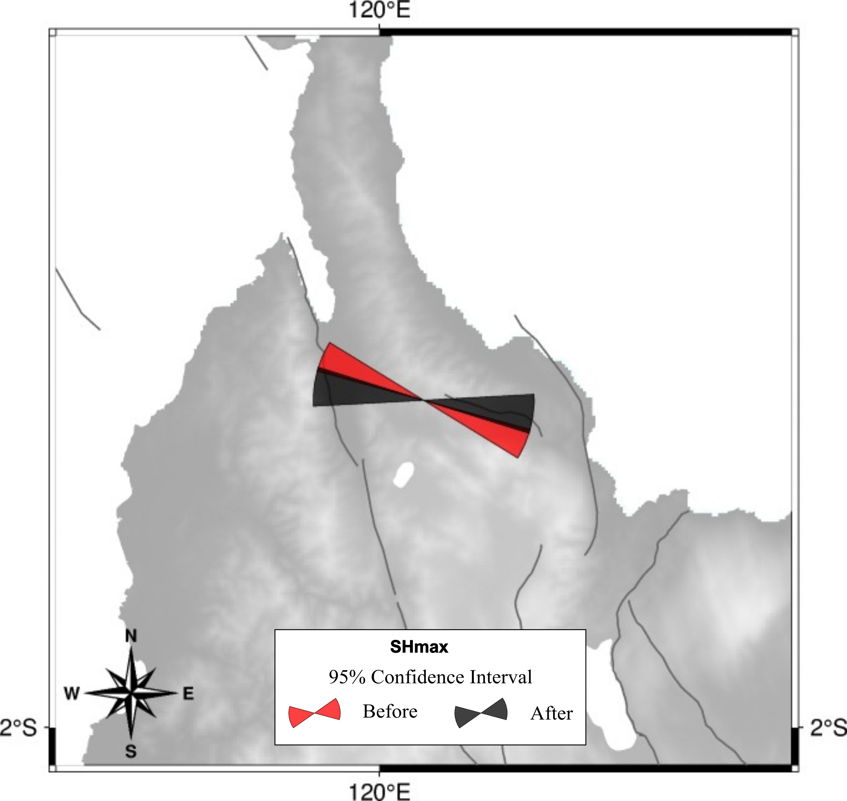
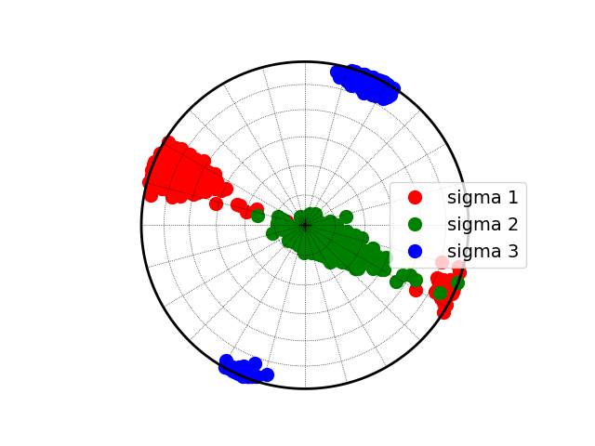
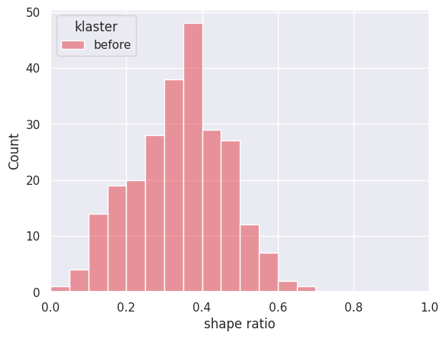
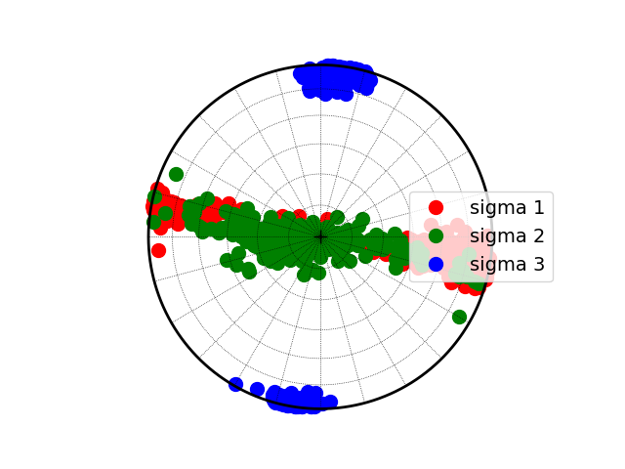
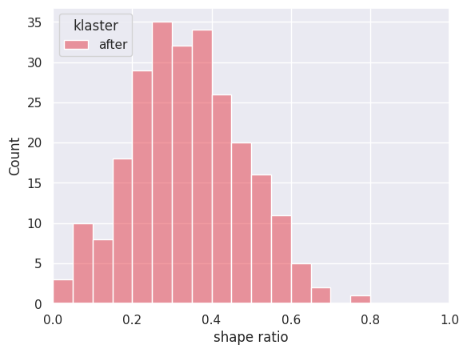
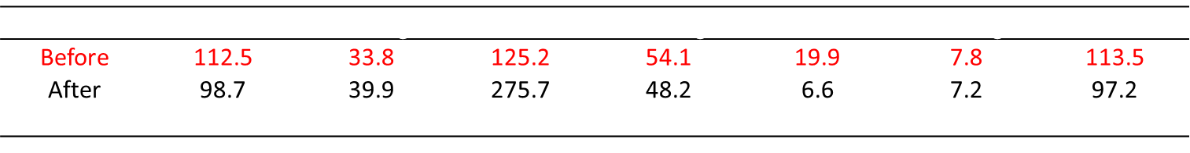
Stress Inversion Result
Before 2018 Mw7.5 Palu
After 2018 Mw7.5 Palu
 | $$σ1 Azimuth$$ | $$σ1 Plunge$$ | $$σ2 Azimuth$$ | $$σ2 Plunge$$ | $$σ3 Azimuth$$ | $$σ3 Plunge$$ | SHmax
Before | 112.5 | 33.8 | 125.2 | 54.1 | 19.9 | 7.8 | 113.5
After | 98.7 | 39.9 | 275.7 | 48.2 | 6.6 | 7.2 | 97.2
$$Δ$$ | -13.7 | 6.2 | 150.5 | -5.9 | -13.3 | -0.6 | -16.4

Slide 4

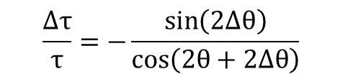
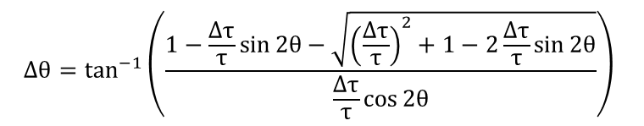
Stress Drop Ratio $\left(\frac{Δτ}{τ}\right)$ Calculation
To calculate the stress drop ratio, we use equation (4) in Hardebeck 2001
$$Δθ=\tan^{−1}\left(\frac{1−\frac{Δτ}{τ}\sin{2θ}−\sqrt{{\left(\frac{Δτ}{τ}\right)}^{2}+1−2\frac{Δτ}{τ}\sin{2θ}}}{\frac{Δτ}{τ}\cos{2θ}}\right)$$
$$\frac{Δτ}{τ}=−\frac{\sin\left(2Δθ\right)}{\cos\left(2θ+2Δθ\right)}$$

Slide 5
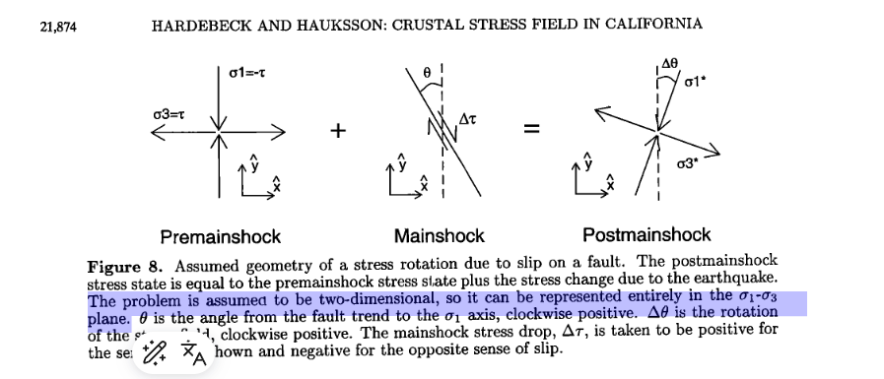
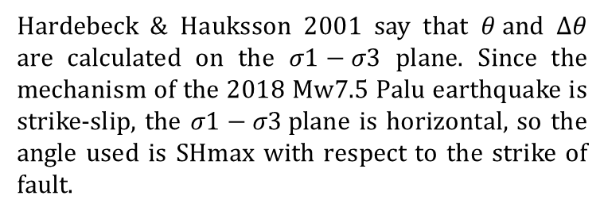

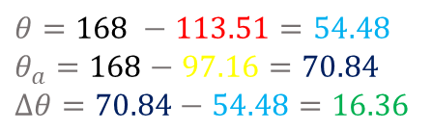

Calculation of $θ and Δθ$
Hardebeck & Hauksson 2001 say that $θ and Δθ$ are calculated on the $σ1−σ3$ plane. Since the mechanism of the 2018 Mw7.5 Palu earthquake is strike-slip, the $σ1−σ3$plane is horizontal, so the angle used is SHmax with respect to the strike of fault.
U
Nodal plane 2018 Mw 7.5 Palu
348$∙$57$∙$-15 87$∙$77$∙$-146
$θ=168 −113.51=54.48$
$θ_{a}=168−97.16=70.84$
$Δθ=70.84−54.48=16.36$
$$Fault | Before | After | θ+Δθ | θ | Δθ$$
S

Slide 6
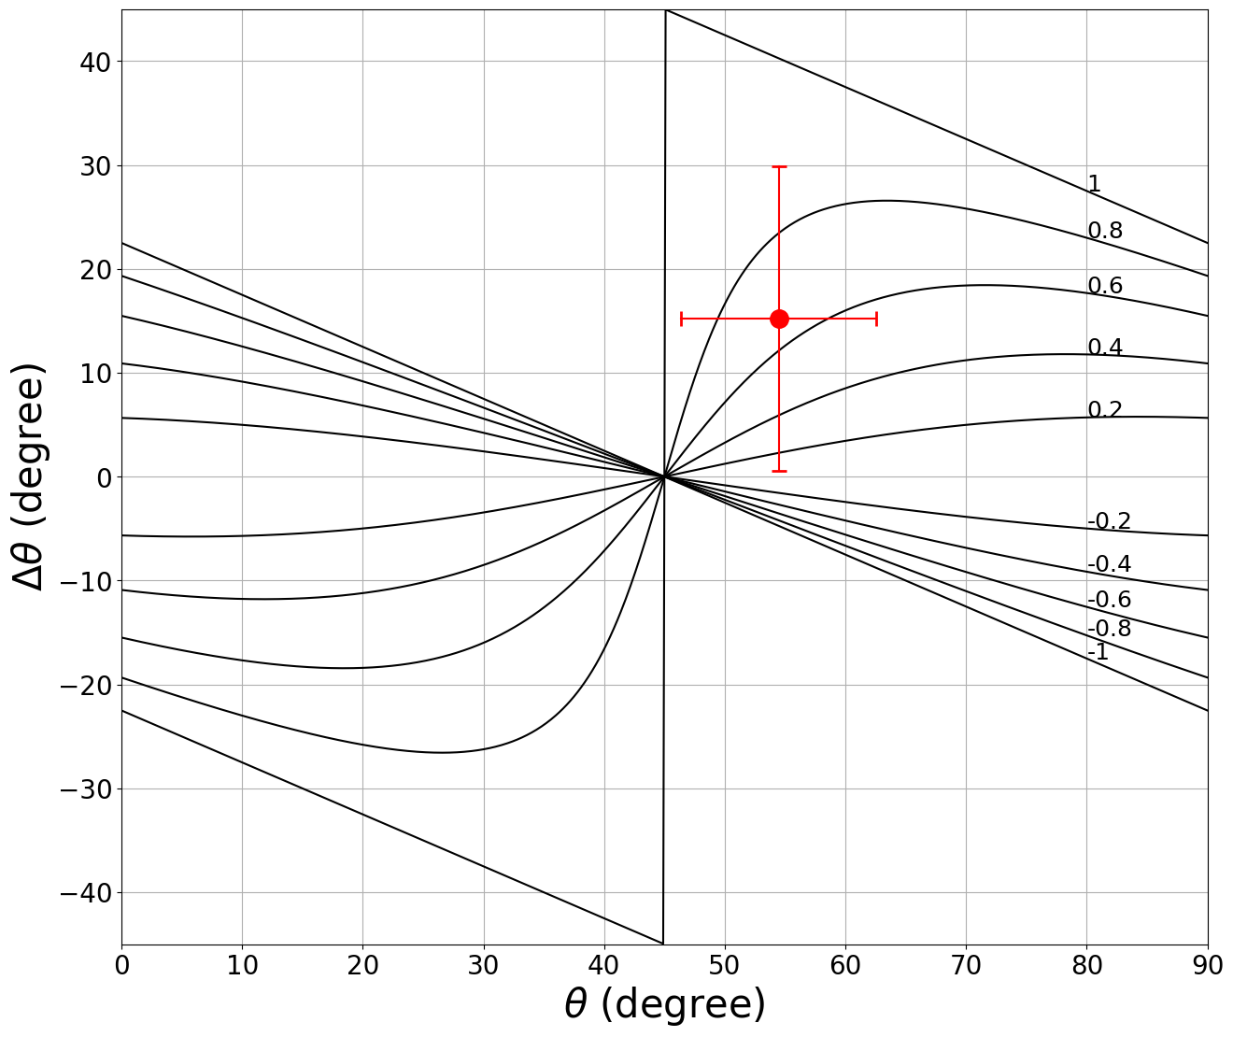
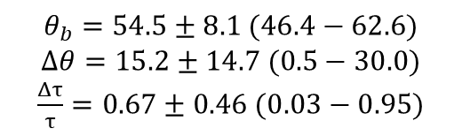
Model Stress Drop 2018 Mw 7.5 Palu by SHmax
$$θ_{b}=54.5±8.1 (46.4−62.6)$$
$$Δθ=15.2±14.7 (0.5−30.0)$$
$\frac{Δτ}{τ}=0.67±0.46 (0.03−0.95)$

